Slide 1

Software Measurement and Analysis
Team
Assignment 11
-------=====-------
K15T2 - Team 2
-------=====-------

Slide 2




Contents
Introduction
Variable Data Definitions
Summary of Current Satisfaction Levels

Slide 3
Introduction
Purpose
Satisfying our customers is an essential element to staying in business in this modern world of global competition.
We must satisfy and even delight our customers with the value of our software products and services to gain their loyalty and repeat business.
One of the best ways to find out is to ask them using Customer Satisfaction Surveys. These surveys can provide management with the information they need to determine their customer's level of satisfaction with their software products and with the services associated with those products.
This report will analyzes provided Viking customer satisfaction data

Slide 4
Introduction
Scope
We sent this survey to our 5 big customers 4 months after Viking release 1 shipped to find out how they were using the product, and how much they liked it. Each customer's response can be found in their Worksheet.
At the time we sent out the survey we had the 5 big customers and also about 20 small (<20 users each) customers. We chose to not send the survey to the small customers because the large customers have thousands more users so they are who we want to please the most

Slide 5
Contents
Introduction
Variable Data Definitions
Summary of Current Satisfaction Levels

Slide 6
Variable Data Definitions
Gender:
Male
Female
Age: Various ages
Below 18
18 – 24
25 – 30
31 – 40
Above 40

Slide 7
Variable Data Definitions
Five-level “Likert Scale”:
5 - Very satisfied
4 - Somewhat Satisfied
3 - Neither Satisfied nor Unsatisfied
2 - Somewhat Unsatisfied
1 - Very Unsatisfied

Slide 8
Contents
Introduction
Variable Data Definitions
Summary of Current Satisfaction Levels

Slide 9
Summary of Current Satisfaction Levels
Important Point Table
No. | Questions | Sections | Point
1 | How often do you use the Viking software? | Frequency | 3
2 | How satisfied are you with your purchase experience? | Purchasing of software | 2
3 | How satisfied are you with your installation experience? | Installation | 1
4 | How satisfied are you with your user experience? | Functionality of software | 4.5
5 | How satisfied are you with your support experience? | Technical Support | 4
6 | Overall, how satisfied are you with our software? | Overall satisfied | 5

Slide 10
Summary of Current Satisfaction Levels
Satisfy Summary Table
Sections | Customer A | Customer B | Customer C | Customer D | Customer E | AVG
1 | 5 | 5 | 5 | 5 | 5 | 5
2 | 4 | 5 | 4 | 4 | 4 | 4.2
3 | 2 | 5 | 3 | 4 | 3 | 3.2
4 | 4 | 5 | 5 | 4 | 4 | 4.4
5 | 4 | 5 | 4 | 4 | 4 | 4.2
6 | 4 | 5 | 4 | 4 | 4 | 4.2
AVG | 3.8 | 5 | 4 | 4.2 | 4

Slide 11
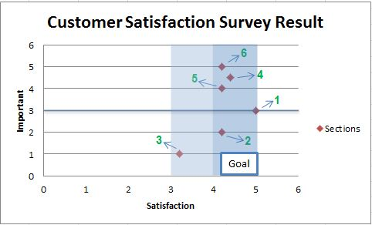
Summary of Current Satisfaction Levels
Analysis Reporting Survey Results
1 - Frequency
2 - Purchasing of software
3 - Installation
4 - Functionality of software
5 - Technical Support
6 – Overall Satisfied
Figure 1: Customer Satisfaction Survey Result

Slide 12
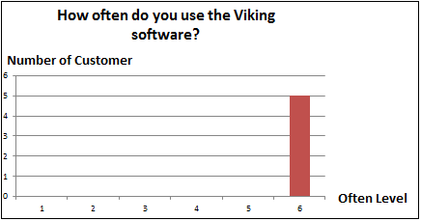
Summary of Current Satisfaction Levels
About times of using the Viking software, the chart shows that they are using the software with highest frequency. This will easier to see in Figure 2.
Figure 2: Question 1 summary

Slide 13
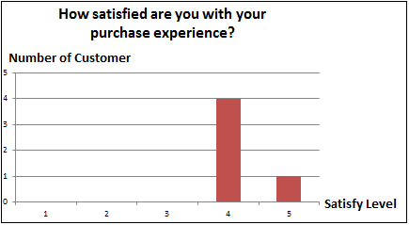
Summary of Current Satisfaction Levels
Figure 3 show that our purchase process (such as purchasing procedures, payment procedures, the delivery time) was done quite well.
Figure 3: Question 2 summary

Slide 14
Summary of Current Satisfaction Levels
The Figure 4 show that not all surveyed customers satisfy with installation process. One of their comments said “many problems with installation”. And their unique environment offered plenty of challenges to our software. Each customer has a different working environment. So we can see that the choice of customers is very different with installation, depending on the adaptation of the Viking for their environment. To satisfy all of them we must increase the important of installation process and research to make Viking adapted to many different environments

Slide 15
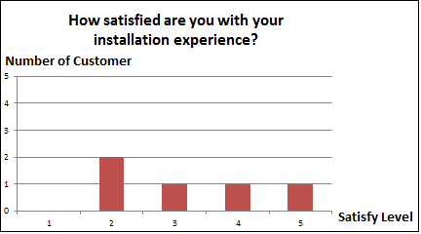
Summary of Current Satisfaction Levels
Figure 4: Question 3 summary

Slide 16
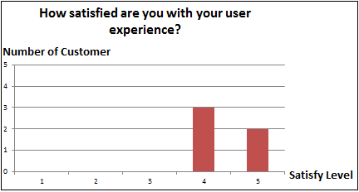
Summary of Current Satisfaction Levels
Figure 5 shows that our customers are very satisfied with Viking software, one of their comments is: “Problems have been resolved quickly” and “Lots of problems but they are resolved quickly” that mean Viking has been done it job well.
Figure 5: Question 4 summary

Slide 17
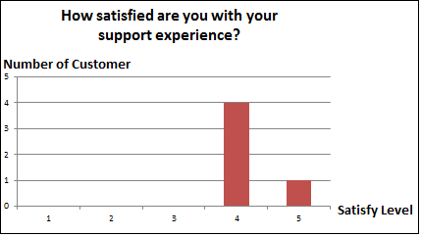
Summary of Current Satisfaction Levels
Our support process, such as guarantee, maintenance is make customer quite satisfied. Figure 6 show that clearly
Figure 6: Question 5 summary

Slide 18
Summary of Current Satisfaction Levels
Conclusion: Figure 7 show the overall satisfy level of our big 5 customer with Viking software, generally, they are impressed with the product, but based on Figure 1 and Figure 4 we can see our installation are not so good, that mean we must focus on this stage, make Viking can be adapted to more environment and easier to install.

Slide 19
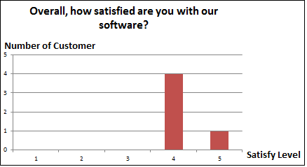
Summary of Current Satisfaction Levels
Figure 7: Question 6 summary

Slide 20
Summary of Current Satisfaction Levels
Customer Analysis
Each customer was satisfied with the different aspects about the product in a different way, to understand a customer was satisfied with what and wasn't satisfied with what from our products will help us found the way to satisfy them.

Slide 21
Summary of Current Satisfaction Levels
Customer Analysis
As we can see below in Figure 8, customer A quite unsatisfied with Viking installation process, that means we need to find out what factors make him comment that our products do not meet him in the stage of installation: the environment, installation steps or something else. Fix these factors will make him satisfy in next release and also keep him in long business with company.

Slide 22
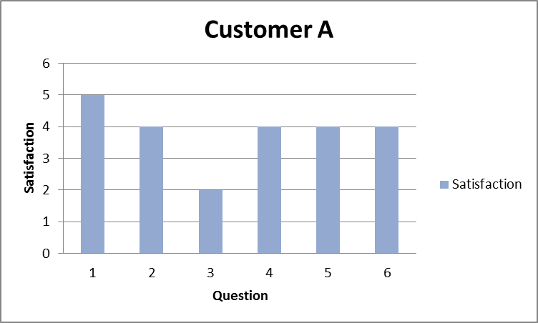
Summary of Current Satisfaction Levels
Figure 8: Customer A summary

Slide 23
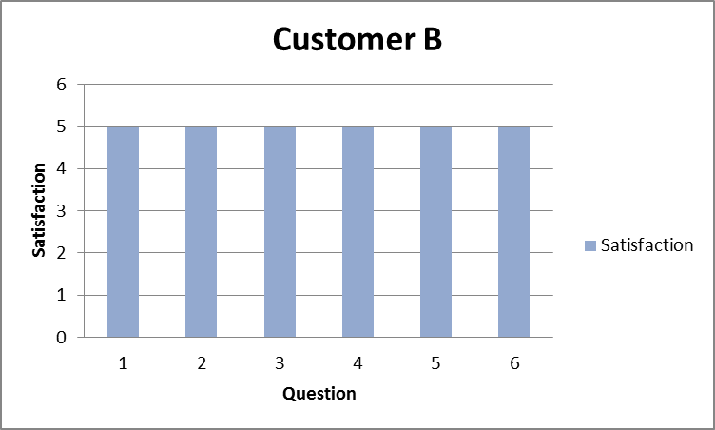
Summary of Current Satisfaction Levels
Figure 9: Customer B summary

Slide 24
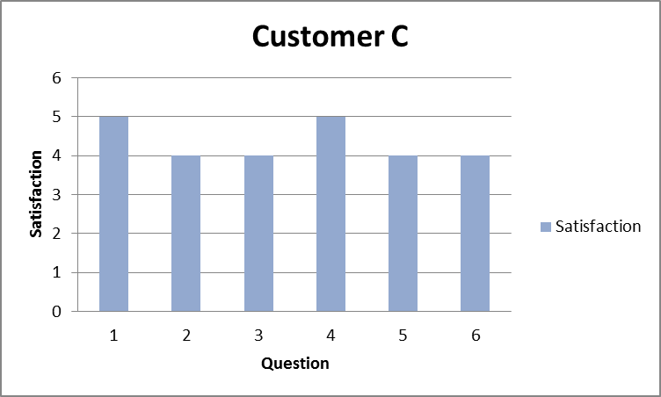
Summary of Current Satisfaction Levels
Figure 10: Customer C summary

Slide 25
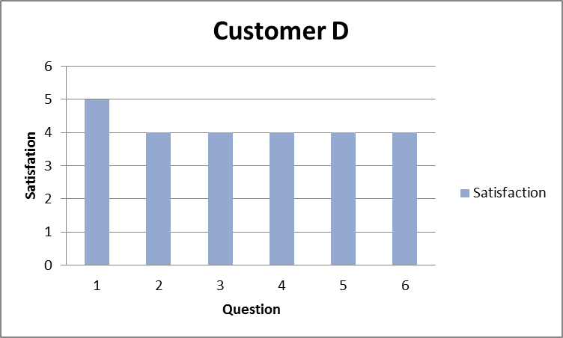
Summary of Current Satisfaction Levels
Figure 11: Customer D summary

Slide 26
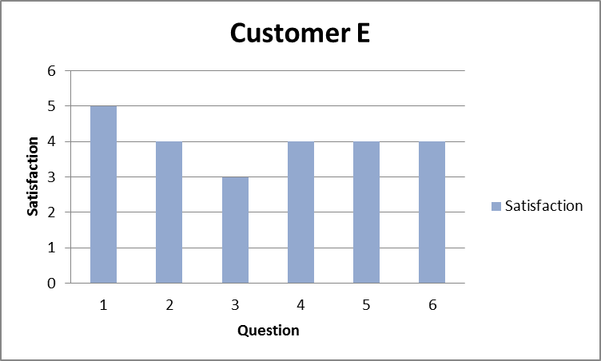
Summary of Current Satisfaction Levels
Figure 12: Customer E summary

Slide 27
Summary of Current Satisfaction Levels
Generally, customers were satisfied with Viking but in installation process still make some customers unsatisfied. We must focus on this point to improve Viking in next release.

Slide 28
Thanks
for your listening!

